Slide 1

IST722 Data Warehousing
Components of the Data Warehouse
Michael A. Fudge, Jr.
Notes:
Chapters 3-8 from the inmon textbook. In this units we’ll explore the pieces and parts required to make data warehousing work.

Slide 2
Project: NopCommerce
Discuss NopCommerce and Project Teams

Slide 3
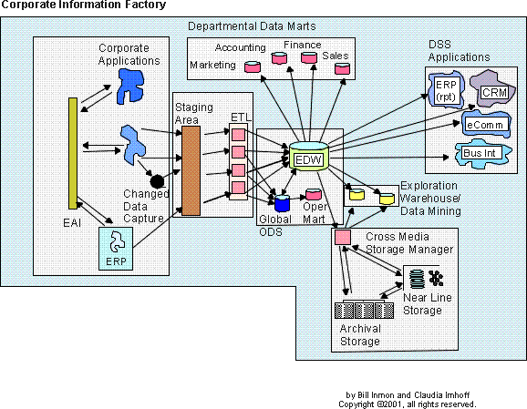
Recall: Inmon’s CIF
The CIF is a
reference architecture
Notes:
As you may recall from our previous unit, data warehousing exists because the structure of our business data is not suitable for reporting – especially long-term trends. Therefore we need to “re-shape” our data to suit the reporting needs of the organization.
Inmon’s corporate information factory is a reference architecture for “data warehousing” it explains the systems and components required to “do” data warehousing.
One thing that might be confusing to you at this point is that the name of this course is “Data Warehousing” yet when you look at this diagram, the data warehouse is the tiny cylinder is the center of the picture.
I think of the term “data warehousing” as the overall activity… collecting, extracting, re-shaping data, then storing it for reporting and analytic purposes. One of the key cogs in this process is the “Enterprise Data warehouse” as described by Inmon. So to me “data warehousing” is represented by all the components you see in this picture, with the Enterprise Data warehouse being one of those components.

Slide 4
Understanding the Diagram
Data Stores
Applications
Components
Processes
The CIF is a
reference architecture
Notes:
Big white boxes – main components
Funny shapes represent applications
Cylinders are data stores – typically in a RDBMS ( Oracle, Sybase, SQL Server) or MOLAP ( Oracle Essbase, IBM Cognos, MS Analysis Services)
Boxes represent processes or programs.

Slide 5
CIF Components
Notes:
Next let’s run down the CIF components in detail

Slide 6
External World & Applications
The CIF is a
reference architecture
Notes:
First we’ll look at the external world and applications – highlighted in yellow

Slide 7
External World & Applications
External World – the people and systems that generate operational data.
Applications – the systems which provide the source for the operational data.
Examples: ERP’s, Business Applications, Internet data, external data streams.
These are the inputs and data sources for the CIF.
OLTP Systems – Operational data, transaction-oriented.

Slide 8
Integration & Transformation Layer
The CIF is a
reference architecture
Notes:
Next we look at the integration and transformation layer

Slide 9
Integration & Transformation Layer
I&T layer – takes un-integrated data from multiple sources and integrates and consolidates it.
Computer programs are written to transform data from the external world into corporate data.
The data come from a variety of sources and in both structured and un-structured formats.
Today’s Database Management Systems provide tooling to assist with this process.
This is the most difficult and time-consuming component of the CIF.
Two approaches: ETL and ELT
Notes:
We’ll use SQL Server Analysis Services
There are two main approaches to data processing in the integration and transformation layer.
1) ETL and 2) ELT

Slide 10
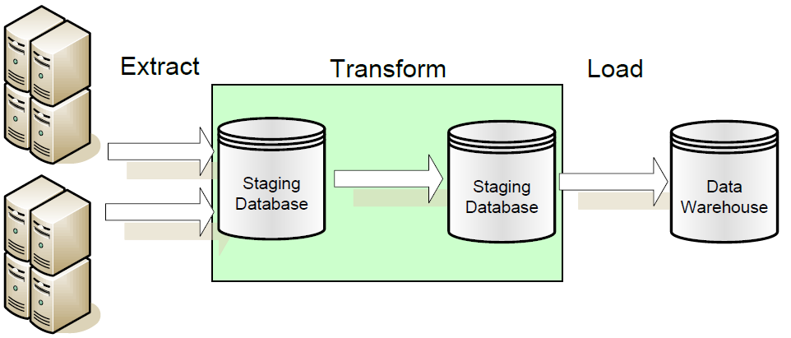
ETL – Extract Transform Load
The data transformation occurs over staged data.
The source data is not stored in the warehouse.
Notes:
To the left are your external world applications.

Slide 11
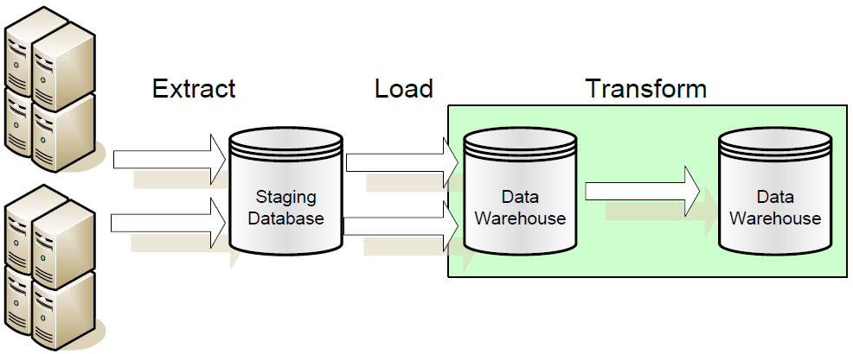
ELT – Extract Load Transform
The data transformation occurs over warehoused data.
The staged data is stored in the warehouse.
Notes:
In ETL you’re not storing pre-transformed data. In ELT you are. The approach you’ll use depends on the cost of transforming the data and the usefulness of the source extract in application of the data warehouse.
For example if you’d want to implement “drill through” to a specific order it might be useful to have the official source extract as a reference.
This situation as a special component of its own, which is the subject of our next slide….

Slide 12
Operational Data Store
The CIF is a
reference architecture

Slide 13
Operational Data Store
Integrated, detailed, and current data from the External World and Applications.
Consolidated from disparate sources.
Does not grow over time.
Performs similarly to a transactional database.
Structured differently than a data warehouse, and therefore should be stored as a separate database.
Receives data from I&T layer sends data to the data warehouse.
The data warehouse can populate it, too.
Think of it as a consolidated operational database.
Notes:
More on this in a bit but first.

Slide 14
Enterprise Data Warehouse
The CIF is a
reference architecture

Slide 15
Enterprise Data Warehouse
Subject-oriented, integrated, summarized, and current data from the External World and Applications.
Optimized for query performance.
Structured differently than operational data, typically in a dimensional model.
Receives data from I&T layer and the ODS.
Use as a source for data marts and decision support systems.
Grows in size over time due to historical data.
The heart of the CIF.

Slide 16
ODS vs. EDW
Characteristic | Operational Data Store | Data Warehouse
Primary Purpose | Run the business on a current basis | Support managerial decision making
Design Goal | Performance throughput, availability | Easy reporting and analytics
Primary Users | Clerks, salespersons, administrators | Managers, business analysis, customers
Subject-Oriented | Yes | Yes
Integrated | Yes | Yes
Detailed Data | Yes | Yes
Summary Data | No | Yes
Time of Data | Current data | Historical snapshots
Updates | Frequent small updates | Periodic batch updates
Queries | Simple queries on a few rows | Complex queries on several rows

Slide 17

Why No ODS in the EDW?
I need fast updates!
I need query performance!
You can’t have both! (Think of the Index!)
Notes:
At the heart of the ODS and EDW debate is that they serve different needs. Talk to any database administrator and they’ll tell you one cannot tune the same database to support both fast queries and fast updates. It’s one or the other.
This is the rational behind the ODS. We put the data which requires updates and changes in our ODS system, and the typically static bulk-loaded read-only DW data in the EDW.
That way both systems can be configured to perform their intended function to the best of their capability.

Slide 18
Data Marts
The CIF is a
reference architecture

Slide 19
Data Marts
A collection of data tailored to the informational needs of a department or business process.
Easy to control, low cost, and customizable due to their limited scope.
Receive their inputs from the Enterprise Data Warehouse.
Are source data for Online Analytical Processing (OLAP) engines.

Slide 20
OLAP
ROLAP
MOLAP
Uses a Relational Database Management System
Data design is the Star Schema
Built on well-known relational concepts
In the EDW.
Uses a Multi-Dimensional Database Management System
Data design is the Cube
Highly flexible, includes Metadata.
Data Marts
Typical implementations have the
ROLAP star schema feed the MOLAP cube

Slide 21
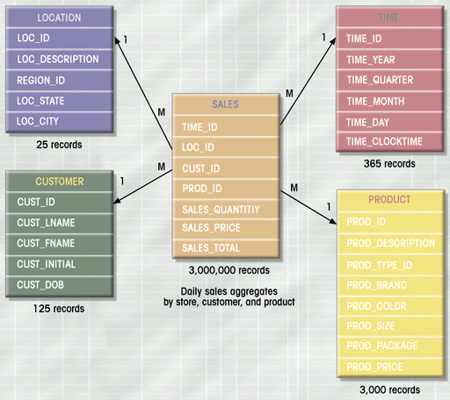
ROLAP – Star Schema
Stored in a relational DBMS
Fact table is M-M relationship among dimensions.
We saw this last week!

Slide 22
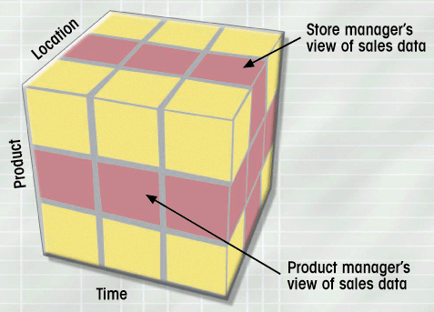
MOLAP - Cube
Stored in a Multi-Dimensional DBMS
Facts are pre-aggregated across all dimensions for improved performance.
Metadata: Drill down hierarchy and Identified Facts

Slide 23
DSS Applications
The CIF is a
reference architecture

Slide 24
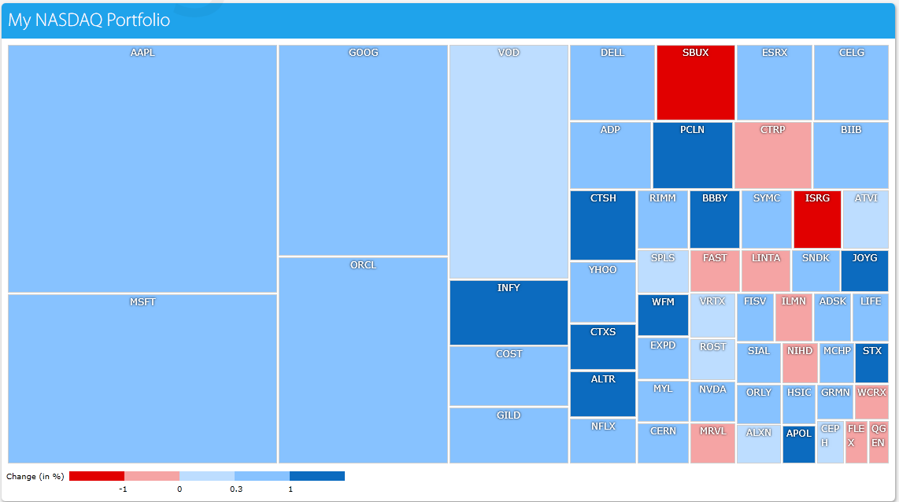
Decision-Support Systems
Business Intelligence.
Front-ends to ROLAP and MOLAP Engines.
Help us explore and visualize information at a high level

Slide 25
Cross-Media Storage
The CIF is a
reference architecture

Slide 26
Cross-Media Storage Manager
Stores historical data which is infrequently accessed.
Moved out of the EDW, which has high-end, performant storage into more affordable storage with less performant access times.
A process exists to enable some transparency in the retrieval process.

Slide 27
Group Activity
Please assemble into your project groups
A through H.
You will work in your teams on a group activity involving product evaluation.

Slide 28
Skill: Evaluating CIF Components
Activity: Research the following products. Match each to the CIF components it was designed to support. Justify your reasoning with sources. Groups will be called upon to present their findings.
Name of Product
CIF Components
Informatica ILM
PostgreSQL
Pentaho Data Integration
Birst
Tableau Server
Oracle Essbase
Microsoft Dynamics GP
IBM Informix
Corporate / External World Application
ETL System
Data Mart / MOLAP
Decision Support System
Enterprise Data Warehouse
Operational Data Store
Cross-Media Storage
Notes:
At minimum research the Product with the same group letter as you first. As time permits, do the remaining products.

Slide 29
In Summary…
The CIF is a reference architecture for building out an information ecosystem.
Applications from the external world are inputs into the CIF.
The Integration & Transformation Layer transforms transactional data into corporate data.
The Operational Data Store contains consolidated, non-historical data.
The Enterprise Data Warehouse contains consolidated historical data.
Data marts are tailored to the informational needs of a department or business process.

Slide 30
IST722 Data Warehousing
Components of the Data Warehouse
Michael A. Fudge, Jr.

